Slide 1
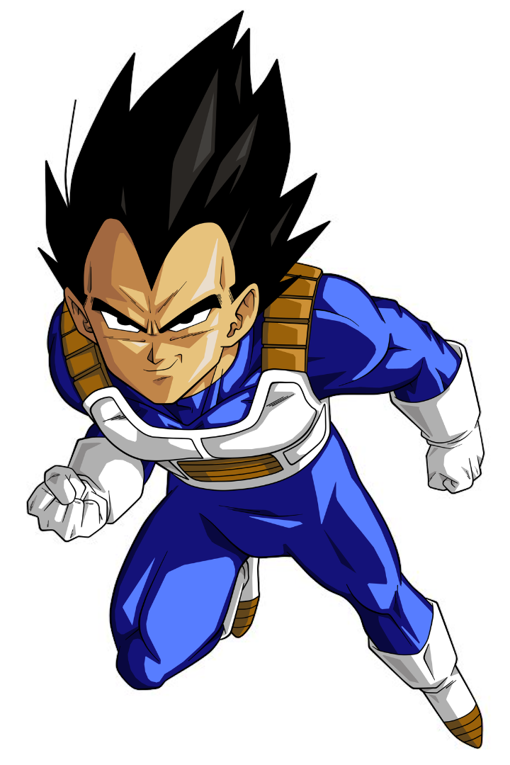
Vegeta, the Prince of all Saiyans
Discover the fascinating journey of Vegeta, the iconic character from Dragon Ball. Explore his growth, iconic moments, and his impact on popular culture.

Slide 2
Vegeta's Background
Royal Saiyan Bloodline
Prince Turned Warrior
Vegeta hails from a noble Saiyan bloodline as the prince of the planet Vegeta.
Once arrogant and power-hungry, Vegeta eventually becomes a powerful ally in the fight against evil.
Bitter Rivalry with Goku
Dynamic Character Development
Explore the complex relationship between Vegeta and Goku, from enemies to training partners and brothers-in-arms.
Witness Vegeta's growth as he evolves from a villain to a hero, always seeking to surpass his limits.

Slide 3

Vegeta's Super Saiyan Transformation
1
Beyond Legendary
2
The Legendary Ascension
Uncover the struggles and sacrifices Vegeta endures to unlock the extraordinary power of the Super Saiyan.
Witness the unforgettable moments when Vegeta, driven by his determination, achieves various Super Saiyan forms.
3
From Rivalry to Respect
Discover how Vegeta's Super Saiyan transformation impacts his relationship with Goku and their joint battles.

Slide 4
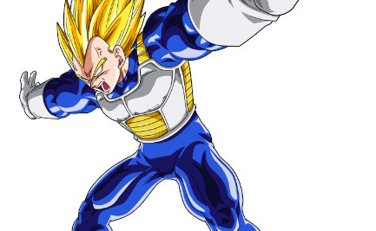
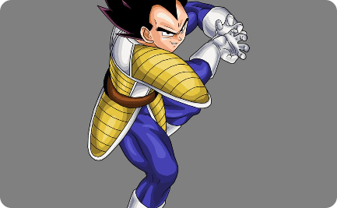
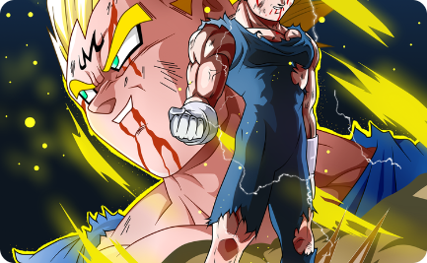
Vegeta's Iconic Moments
Final Flash
Galick Gun
Majin Vegeta
Relive the epic moment when Vegeta unleashes the devastating Final Flash attack against Cell.
Witness the sheer power of Vegeta's infamous Galick Gun technique, obliterating his opponents.
Dive into the conflicted psyche of Vegeta as he embraces darkness in his pursuit of power as a Majin.

Slide 5
Vegeta's Role in the Dragon Ball Franchise
1
Battles that Define
Explore the key battles where Vegeta's determination and strength make a crucial impact in the Dragon Ball series.
2
Redemption and Sacrifice
Discover how Vegeta's redemption arcs and selfless acts contribute to the overarching storyline of Dragon Ball.
3
Legacy and Future
Reflect on Vegeta's enduring legacy and his potential role in future Dragon Ball series.

Slide 6

The Impact of Vegeta on Popular Culture
1
Inspiring Cosplayers
2
Quotes that Resonate
Discover the influence of Vegeta's striking design and character on the cosplay community.
Explore Vegeta's memorable quotes that have become iconic within the Dragon Ball fandom.
3
Internet Memes Galore
See how Vegeta's personality and quotes have permeated internet culture, spawning countless memes.

Slide 7
What We Can Learn from Vegeta
Determination
Growth and Redemption
Strength in Unity
Vegeta's unwavering determination teaches us the importance of relentless pursuit towards our goals.
Through his evolving relationship with Goku, Vegeta shows the power of unity and teamwork in achieving greatness.
Vegeta's character growth and redemption arc inspire us to learn from our mistakes and become better individuals.

